Slide 1



An Expresso Session on ‘Being an engaging Facilitator’
1

Slide 2
Your need as we understand
You wish to conduct a workshop for your 16 Training Managers to build Essential Training Delivery Skills. You want us to lead a half-day session on 10th March (8 am to 2 pm) at your office in One Horizon Centre.
The key focus of this session should be on the below 2 topics :-
· Preparation | How to prepare for an effective training delivery
· Engagement | Effective ways of Connecting/Engaging with the audience
Situation
Problem
Once Tanaya confirms the dates, we’d get into a longer discussion to understand where the current training managers are failing to make an impact.
Need
You’d like for this session to be an active learning space where the training managers learn by doing.

Slide 3
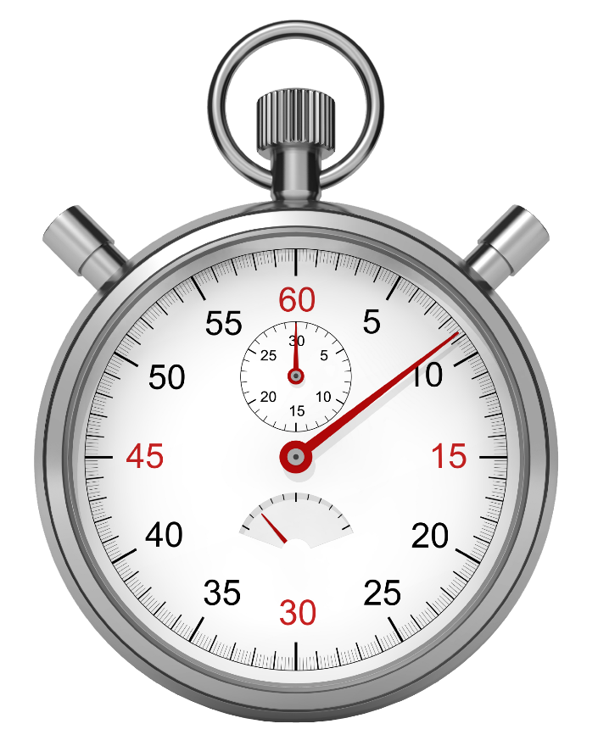
EXPRESSO Sessions
The Expresso sessions are perfect for providing learning and development in easy-to-digest
modules. Information is relayed quickly and easily as people are encouraged to actively participate in the sessions, which increases the effectiveness of our personal development courses
Why do these work in such a short space of time?
First, we take a topic that is manageable within a short time frame.
Secondly, they are experiential; rather than being talked at, participants try new ways of thinking and doing. We create a safe, stimulating environment to rehearse new ways of performing.
These Expresso sessions are intense learning experiences – fast, fun, focused, and packed with a huge amount of know-how in an incredibly short time.
2

Slide 4
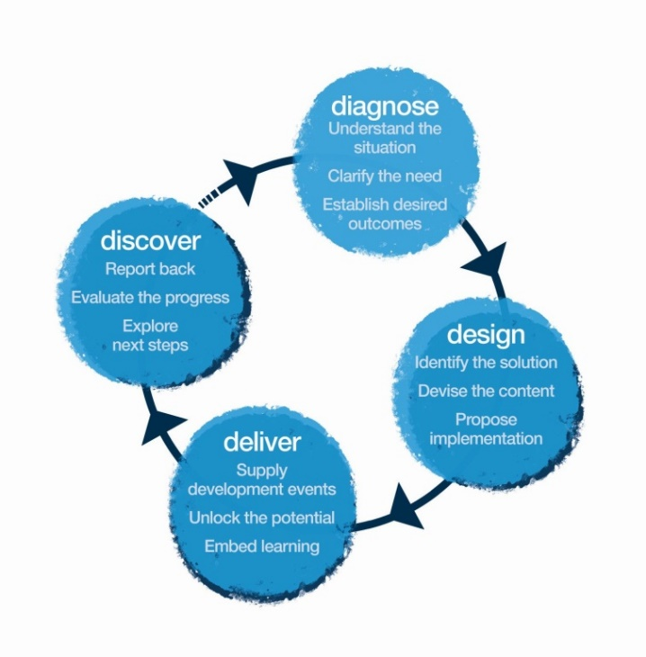
Sample Learning Objectives- After the workshop, the participants will:
Think
Spending time in preparing helps ease nerves and be more present in my sessions.
My sessions should be engaging (Left and right brain friendly) rather than only giving downloads
Learning happens more by doing than by only listening.
Feel:
Confident to create better impact.
Enthusiastic about trying different ways of engaging my participants.
Be more able to:
Make the content more logical and creative.
Make each session different from the other.
Prepare well before sessions.
4

Slide 5
Tentative Design- Half-Day Session [1 MaynardLeigh Consultants for 16 Participants]
Narrative | Session | Session Details | Outcome
Impactful facilitation is a vast subject! Today we will just take a glimpse at some of the elements that go into creating powerful learning sessions. | Context Setting | Consultant introducing Maynardleigh and Theatrical warm up | Facilitator Led
Let's begin by looking at our current state and discovering what we need to work on. | 3 Minute Facilitation | Participants are divided into pairs for them to do a 3-minute presentation, presenting a section from their workshops. Participants offer each other feedback on what’s working and areas of development. | Participant led
Preparation & Engaging Audiences
We create meaning and communicate using more than just our words, then why do we spend all our time in preparing just the our training decks. Preparation of the voice, breath and body are also deeply connected to the ability to manage nerves. Let's create a preparation routine for ourselves. | Voice-Body-Breath-Mind | Preparing your physical self: body, Breath, Mind and voice exercises. Being able to handle nerves, and use our whole body to create an experience. | Theatrical Exercise
The flow of our workshops is important to ensure retention from the participants. It is important to engage both left and right brain of our participants. Powerful workshops flow seamlessly like a story. | Storyboarding- Engaging Left and Right brain. | Preparing the content - Story boarding/ story spine | Introducing the concept. Experiential Exercise
Closing- Final presentations and feedback
To internalize the learning we’d ask the participants to incorporate their feedback and take another shot with their morning presentation. | Practice, Rehearsal and Feedback. | Participants make another deck for their 3 minute pitch and incorporate the feedback received and use the storyboard tool to engage. | Celebrating the movement and the change. Re-enforcing the learning.
5

Slide 6

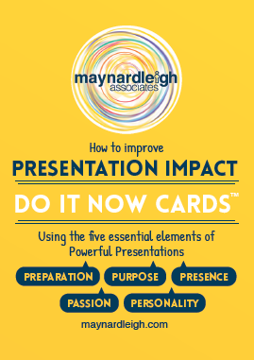
Learning Collaterals
The Perfect Presentations Book
Each participant receives a copy of the “Perfect Presentations” book by Andrew Leigh & Michael Maynard. This will help them with tools to make their sessions more powerful and consolidate the learning from our session.
Click to look inside
Do-It-Now Cards
At the end of the journey, each participant receives a Do-It-Now cards set which offers inspiring and practical ideas participants can use to make an impact in their sessions.
This is a handy tool to ensure the learning are practiced post the journey.
7

Slide 7
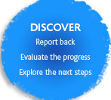

Discovery meeting
A one to one meeting with leader and L&D partner to review the journey and devise the next intervention for the same audience.
8

Slide 8
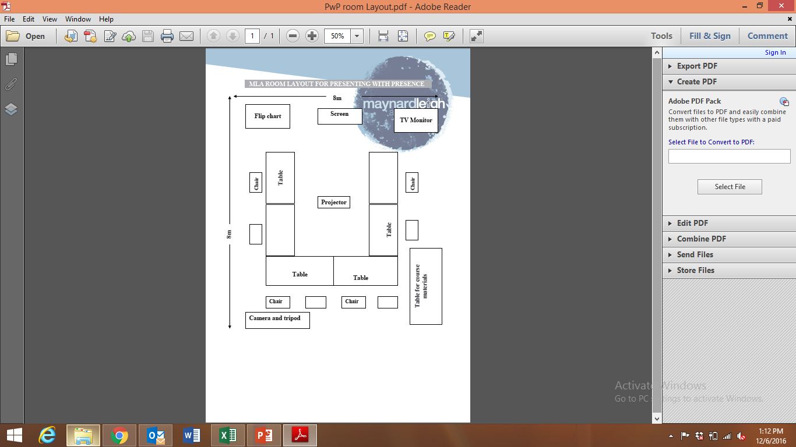

Ambience
We love alternative ways of setting up a workshop! Creating an atmosphere where the participants feels absolutely comfortable and yet challenged. In this workshop, the use of theatre, team games and experiential methodologies are essential ingredients, hence we’d require ample place to move around and make noise.
Please book a space with ample natural light (Yes, we want sunlight streaming in) and no fixed furniture for the leaders to work with one MaynardLeigh consultant.
9

Slide 9
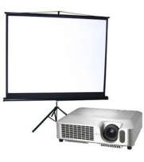
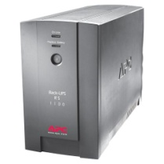
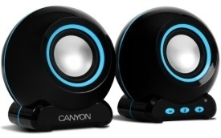



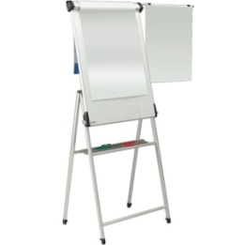
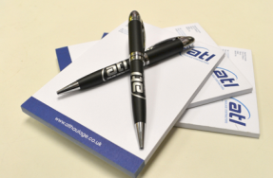

Things Required at the Venue
For the workshop, we will need the below mentioned:
LCD projector and projection screen 8×10 feet
UPS Power Back-up for Laptop, LCD projector & Laptop speakers
TV with Remote for Video playback
External speakers (for laptop connectivity). The external speakers should be loud
enough to play music for the team.
White board & White board markers (2 blue, 2 black, 2 green)
Flip chart and Flip chart stand with suitable clips
Colour pens (Normal sketch pens - about 30)
Notepads and pens (for participants)
Blu Tac (This substance is used to stick things, posters or paper on the wall)
20 A4 Size normal and drawing sheets
2 tables for the consultant( one will be used for the projector and the other for keeping the handouts)
10

Slide 10
Your Investment for the intervention
Delivery (for a batch of 16 participants)
Activity | Investment
Professional Fee for delivery – Presenting with Presence Workshop | INR 40,000 Per half Day per consultant X 1 Days X 1 Consultant s | INR 40,000/-
Learning Material, Folders, Perfect Presentation books and DO IT NOW cards | INR 800 X 16 (Charged on actuals) | INR 12,800/-
Total Investment covering 16Participants |  | INR 52,800/-
11

Slide 11
Commercial Terms & Conditions
Client is responsible for providing venue, conference facilities, AV equipment.
Travel outside Delhi NCR - Air, stay & airport/ venue cab transfers to be taken care by the client.
Travel inside Delhi NCR - at Rs. 12.00 Per Km.
Not inclusive of applicable taxes (service tax @ 15.00%).
A commercial contract will be signed before the execution of the project.
50% of cancellation fee will be charged on any cancellation or postponements that occur within 3 to 20 working days of the confirmed date of delivery.
100% of cancellation fee will be charged on any cancellation or postponements that occur within 0 to 2 working days of the confirmed date of delivery.
The above commercials are valid till the 31st March, 2017
Contracts, legal & accounting paperwork (including billing & payments) will be in the name of “Life Strategies Humancare Pvt. Ltd.”
12

Slide 12

Next Steps
Contract and PO: Given this workshop is in March, please expedite the PO creation.
Book: Once we receive the PO, we will book the dates and ensure we have the consultants available for you
13

Slide 13
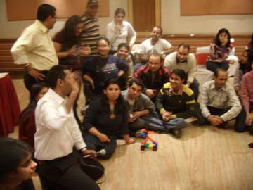
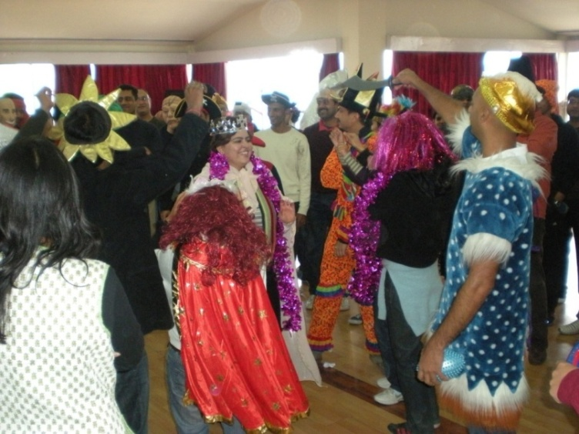
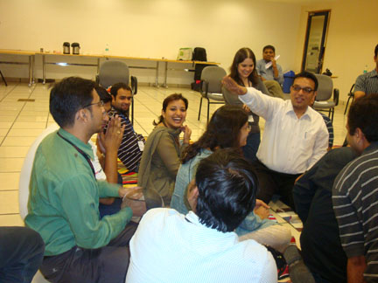
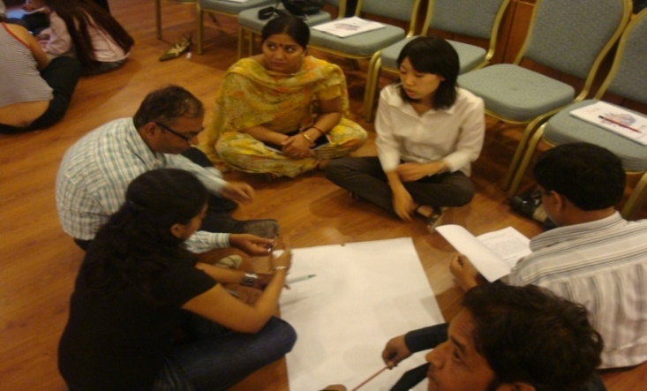

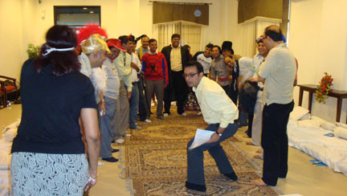
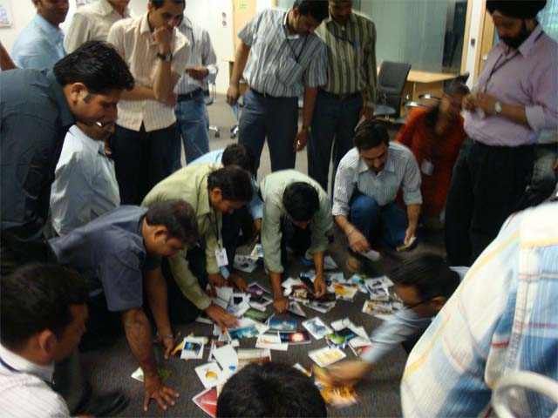
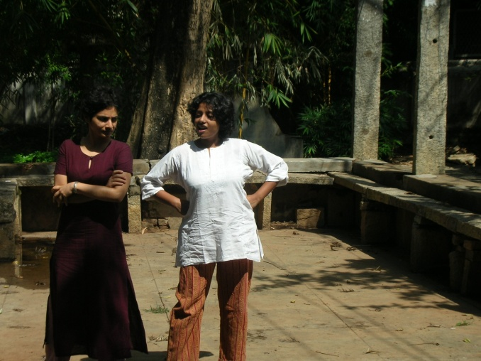
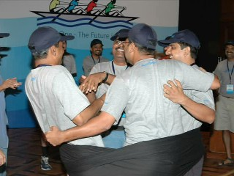
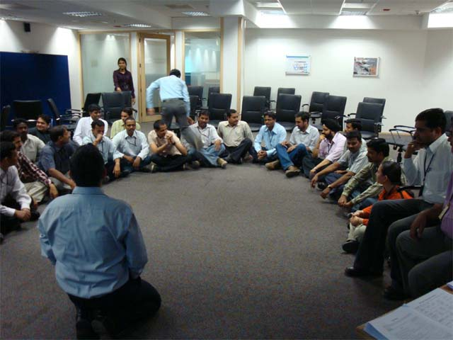
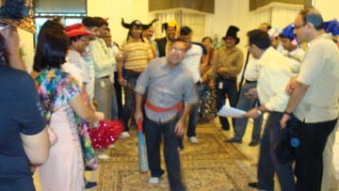

Slide 14

Let’s work in partnership to create impact & unlock potential
For further information please connect with:
Contact Jigyasa Sharma/ Varun Gupta
Email jigyasa@maynardleigh.in / varun@maynardleigh.in
Telephone +91 9717922445/ +91 9560192443

